Slide 1

B.Tech. Computer Science and Engineering (Information Security)
BCSE497J - Project-I
CareChain
Team member:
Ashish Anil Sikaria (23BCI0218)
Faculty guide :
Dr. Selvi M
Project Review 3 | 28-10-2026
Notes:
Introduce CareChain: a patient-controlled health record system. Review 3, 28 October 2026.

Slide 2
Approval Mail From Guide
Notes:
Replace the dashed box with the screenshot of the actual approval mail and fill in the Turnitin values before presenting.

Slide 3
Aim
To build CareChain, a patient-controlled health record system in which every download is checked against the live permission and the doctor's licence, and readable data never reaches the server disk.
Patient owns access
Grant and revoke are signed by the patient's own wallet.
Live check
Permission and licence are checked when the file is decrypted.
Decrypt in memory
Plaintext streams from RAM. Nothing readable is written to disk.
Detect tampering
AES-GCM tag and the on-chain CID are checked before release.
Design target: a patient-visible, tamper-evident record system whose cost on the chain does not grow with file size.
Notes:
The aim in one line, then the four ideas that follow from it.

Slide 4
Abstract
Hospital record databases are single points of failure: one leaked admin key exposes everyone, and a revoked doctor may keep reading from a cache.
CareChain splits the work: React portals, a Node.js gateway, IPFS for encrypted files, and a Solidity contract for the doctor registry, permissions and events.
Login is a signed wallet challenge, so there are no passwords. Files are encrypted with AES-256-GCM and only the CID goes on the chain.
Key idea, the dual-gate download: session, then live permission and licence, then integrity checks, then decrypt in RAM and stream.
Tested with an 11-case contract suite, an end-to-end API run and benchmarks on 1,000 synthetic records.
Results: a doctor is denied before a grant, served after it and denied again on the first request after a revoke; a tampered file releases nothing.
~300k gas
first record upload, for any file size
0 bytes
written to server disk (disk proxy: about 424 KB)
375 of 375
tampering and spoofing trials rejected
Notes:
Problem, parts, key idea, evidence, and the honest status in the last bullet.

Slide 5
Literature Review (1 of 2): Research Papers
Paper | Objective | Methodology | Pros / Cons | Findings
MedRec, Azaria et al., 2016 [1] | Patient-controlled access to medical data | Ethereum smart contracts manage permissions; records stay in provider storage | + Tamper-resistant log - Storage stays with providers, no live licence check | Foundational design; plaintext leakage on a serving server is not addressed
Reen et al., IEEE CICT 2019 [5] | Patient-centric e-health records | Permissioned Ethereum, symmetric and asymmetric crypto, IPFS, patient grant or revoke | + Encrypted records on IPFS - Hospital-level access, no licence registry, no RAM-only step | Closest in storage design
Pilares et al., Sensors 2022 [6] | Address EHR challenges with blockchain and IPFS | Reviews 65 proposals, finds 14 challenges, proposes EHRChain on Hyperledger Sawtooth and IPFS | + Confirms blockchain with IPFS - Framework level only | Leftover decrypted files and live licence checks not addressed
Romel et al., arXiv 2025 [7] | Separate storage from access control | Per-patient contract, signed time-limited permissions, off-chain FHIR data | + About 78k gas per grant - Silent on plaintext on intermediate servers | Under 1.5 s access to a 1 MB record reported
Kenaza et al., arXiv 2026 [8] | Interoperable EHR access control and sharing | Private Hyperledger with IPFS; contracts give patients exclusive control | + Works with provider systems - Private network, no wallet login or per-request live query | Zero-disk streaming not addressed
Notes:
Walk the table by column. The takeaway line is the bridge to the research gap.

Slide 6
Literature Review (2 of 2): Prior Patents
Patent | Description | What it offers | Relevance to CareChain
US 12,235,984 B1 [9] | Patient-owned data with revocation and an immutable audit log | Closest existing system | Does not address server leakage during streaming or an active licence check at decryption
US 11,244,059 B2 [10] | Blockchain for managing access to medical data | Access rules on the chain | Separates the access check from decryption, so servers can serve old or cached data
US 12,292,997 B2 [11] | Inter-hospital record access authentication on blockchain | Hospital-to-hospital sharing through server brokers | CareChain lets patients share directly with verified doctors using wallet signatures
CN 112863629 B [12] | Record storage combining IPFS and blockchain logs | Encrypted files on IPFS | Lacks live doctor licence verification and the dual integrity check
US 11,862,304 B1 [13] | Patient-authorized storage; master index checked, blockchain transaction grants access | Patient controls who may send or receive | Authorization is enforced at transfer time; no live check at decryption, no in-memory streaming
Common gap: the access check and the decryption are separate events, and the doctor's licence is rarely part of the decision.
Notes:
Walk the table by column. The takeaway line is the bridge to the research gap.

Slide 7
Research Gap
Gap | In typical designs | CareChain response
Check and decrypt are separate | Permission is read earlier or cached, so a revoked doctor keeps reading | Dual-gate method checks permission and licence at the moment of decryption (benchmarked)
Plaintext touches the disk | Temporary files remain on the gateway | Decrypt and stream from RAM: 0 bytes written (measured)
One integrity check only | Storage or metadata is trusted, not both | GCM tag plus on-chain CID comparison
Licence is outside access | An unverified or expired doctor can receive records | Verified-practitioner registry in the contract, managed by the hospital admin
Passwords still used | A stolen password database breaks the design | Single-use wallet challenge (built and tested)
Notes:
Five gaps, each paired with what CareChain does and how far it is built.

Slide 8


Objectives
Patient ownership: no hospital or doctor decrypts a file without the patient's verifiable permission.
Stop server leaks: decrypted files stream through RAM and are never saved on the server disk.
Immediate revocation: a patient or licence revocation stops access on the next request.
Verify integrity: tampering or corruption is detected and blocked before delivery.
Remove passwords: one-time wallet signature challenges replace them.
Identified SDGs: SDG 3 and SDG 9
Readiness: TRL 4 (lab validated)
Outcome
Patent: IDF is prepared and ready to be filed.
Notes:
Each objective maps to a measurement in the results. SDG 3 (health) and SDG 9 (innovation). TRL 4 as recorded in the IDF: technology validated in a laboratory environment.

Slide 9
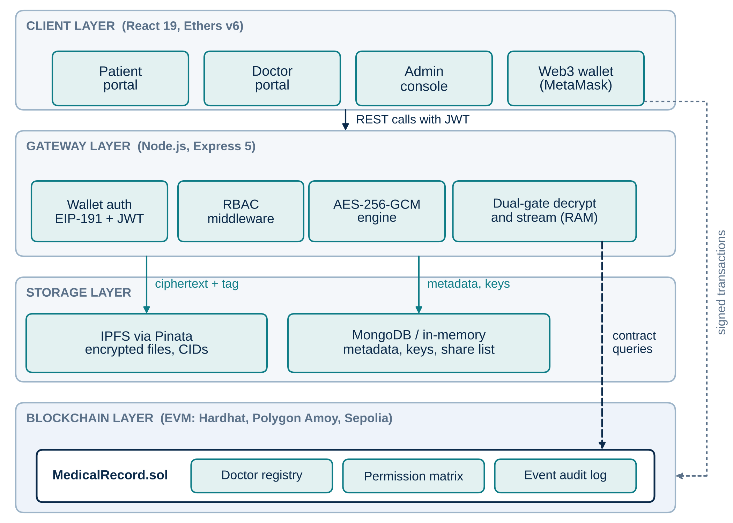
Framework / Architecture / Block Diagram
Four layers
Client: React portals for patient, doctor and admin, with a MetaMask wallet.
Gateway: Node.js and Express. Wallet login, JWT, roles, AES-256-GCM.
Storage: IPFS holds ciphertext only. MongoDB holds metadata, keys and the share list.
Chain: MedicalRecord.sol holds the doctor registry, permission table and events.
Notes:
Rules and history on the chain; bulky and private data off it. Only the CID is stored on-chain, so cost does not depend on file size.

Slide 10
Functional Requirements
ID | Requirement | Checked by
FR1 | Sign in by signing a one-time challenge with a wallet; no password | API demo, steps 1 to 4
FR2 | Encrypt an upload with AES-256-GCM and store only ciphertext on IPFS | API demo, steps 5 and 6
FR3 | Register title, type and CID, visible as an on-chain event | Contract tests
FR4 | Patient grants or revokes a doctor and it applies to the next request | Contract tests, API demo 7 to 11
FR5 | A doctor sees and downloads only records shared with that doctor | Contract tests, API demo
FR6 | Administrator verifies or revokes a doctor's licence | Contract tests, admin console
FR7 | Before decryption check session, permission, licence, then integrity | API demo and benchmark
FR8 | Stream decrypted data from memory; never write it to disk | API demo 14 and benchmark
Notes:
Every requirement is checkable by a test or a run. FR7 is the one that is only partly built.

Slide 11
Modules
1. Smart contract
MedicalRecord.sol: doctor registry, permission table, record pointers and events. Covered by 11 test cases.
2. Wallet login
EIP-191 challenge with a 256-bit nonce, 10 minute expiry, nonce rotated, then JWT.
3. Encrypt and store
AES-256-GCM with a fresh key and IV per file. Ciphertext pinned to IPFS, CID returned.
4. Dual-gate stream
Session check, permission and licence check, CID and tag checks, then decrypt in RAM and stream.
5. Access and licence
Patients grant and revoke access. The hospital admin verifies or revokes doctor licences.
6. Role portals
React portals for patient, doctor and admin with wallet signing.
Notes:
Six modules. Module 4 is the focus of the invention disclosure.

Slide 12
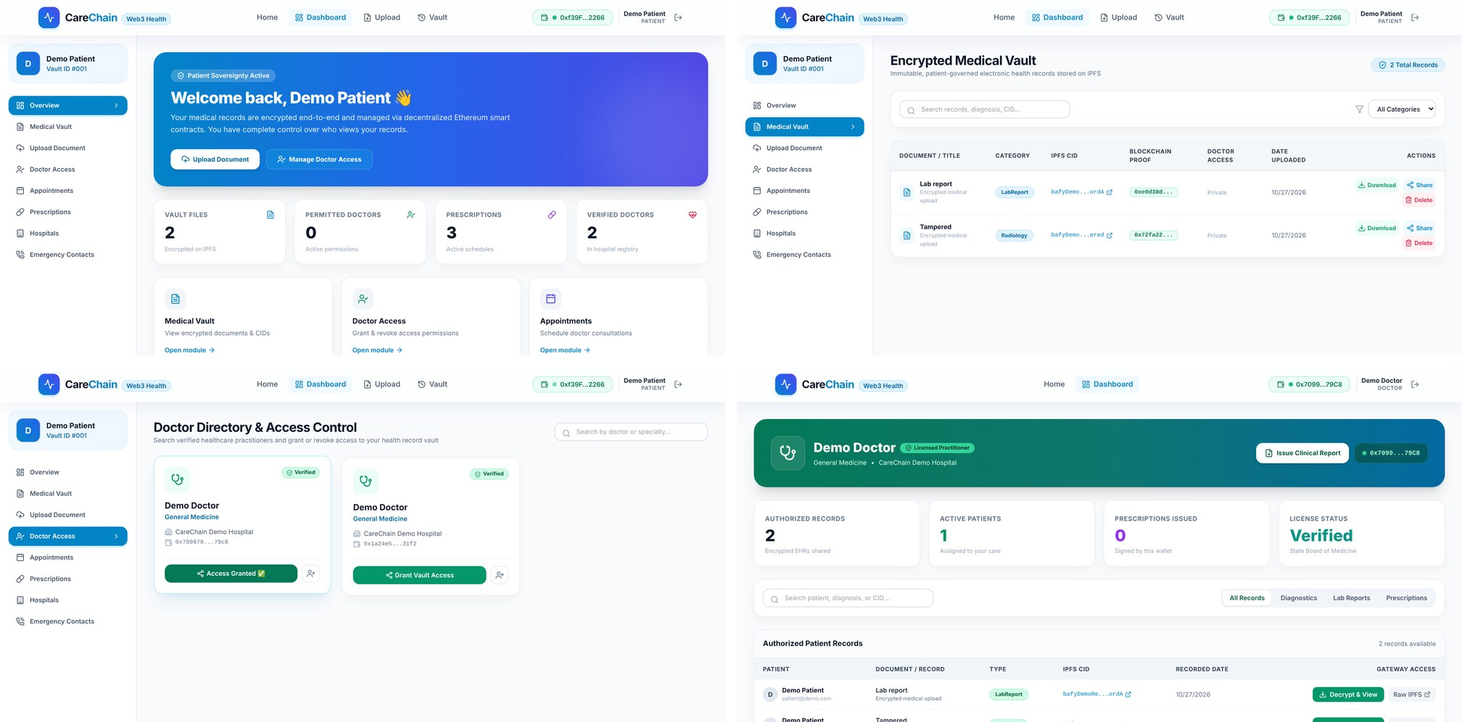
Experiments and Results (1 of 2): Working Prototype
End-to-end API run | Result
Replay of a captured login signature | 401 rejected
Doctor downloads before any grant | 403 denied
Doctor downloads after the grant | 200, bytes identical
Doctor downloads right after revoke | 403 denied
One flipped ciphertext bit | 500, no plaintext sent
New files in server temp folder | 0
Patient vault and doctor portal of the running prototype
11
contract test cases
300,065
gas, first addRecord
45,910
gas, grant access
24,019
gas, revoke access
Notes:
Left: real screenshots of the running portals. Right: the access cycle, denied then granted then denied. Gas measured on a local EVM; no file-size dependence because only the CID is stored.

Slide 13
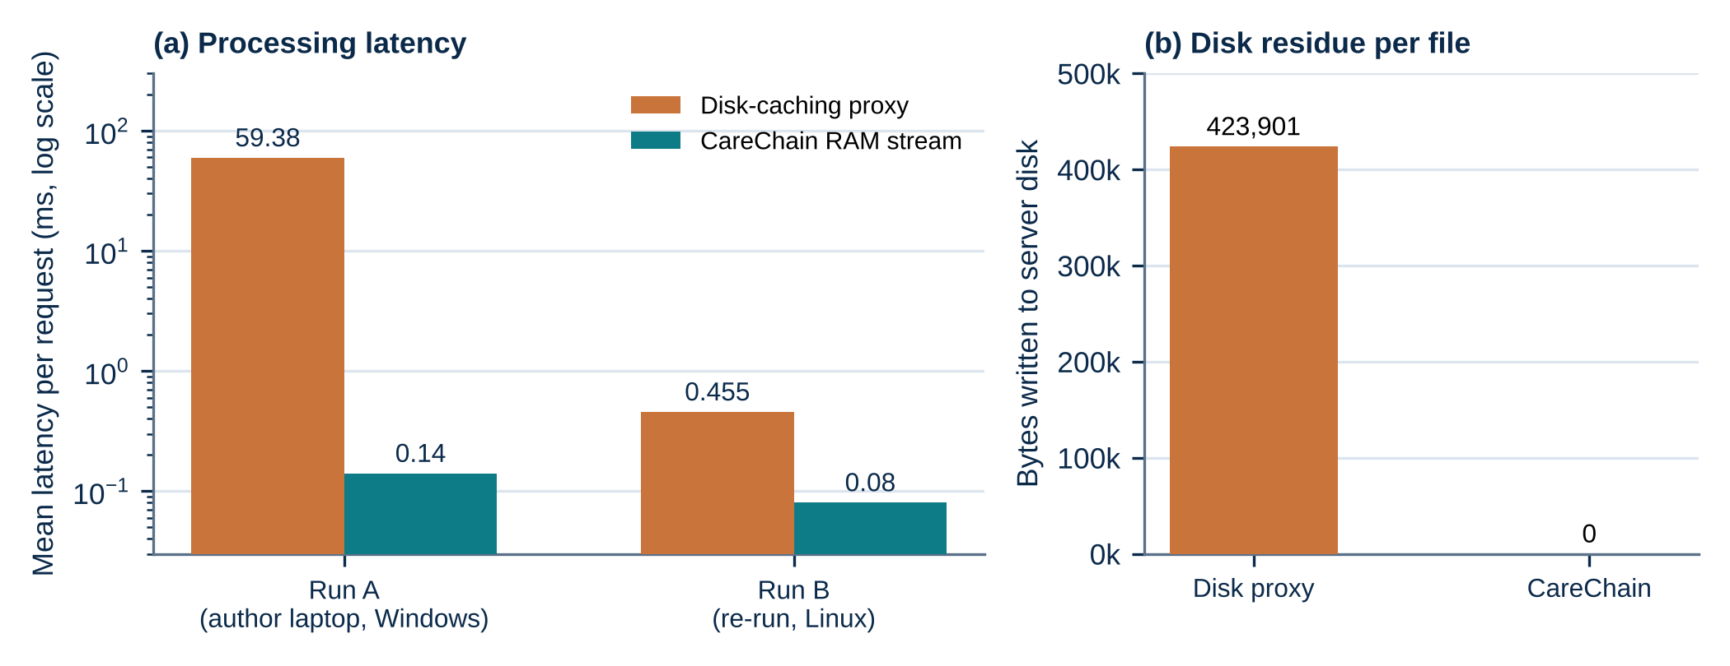
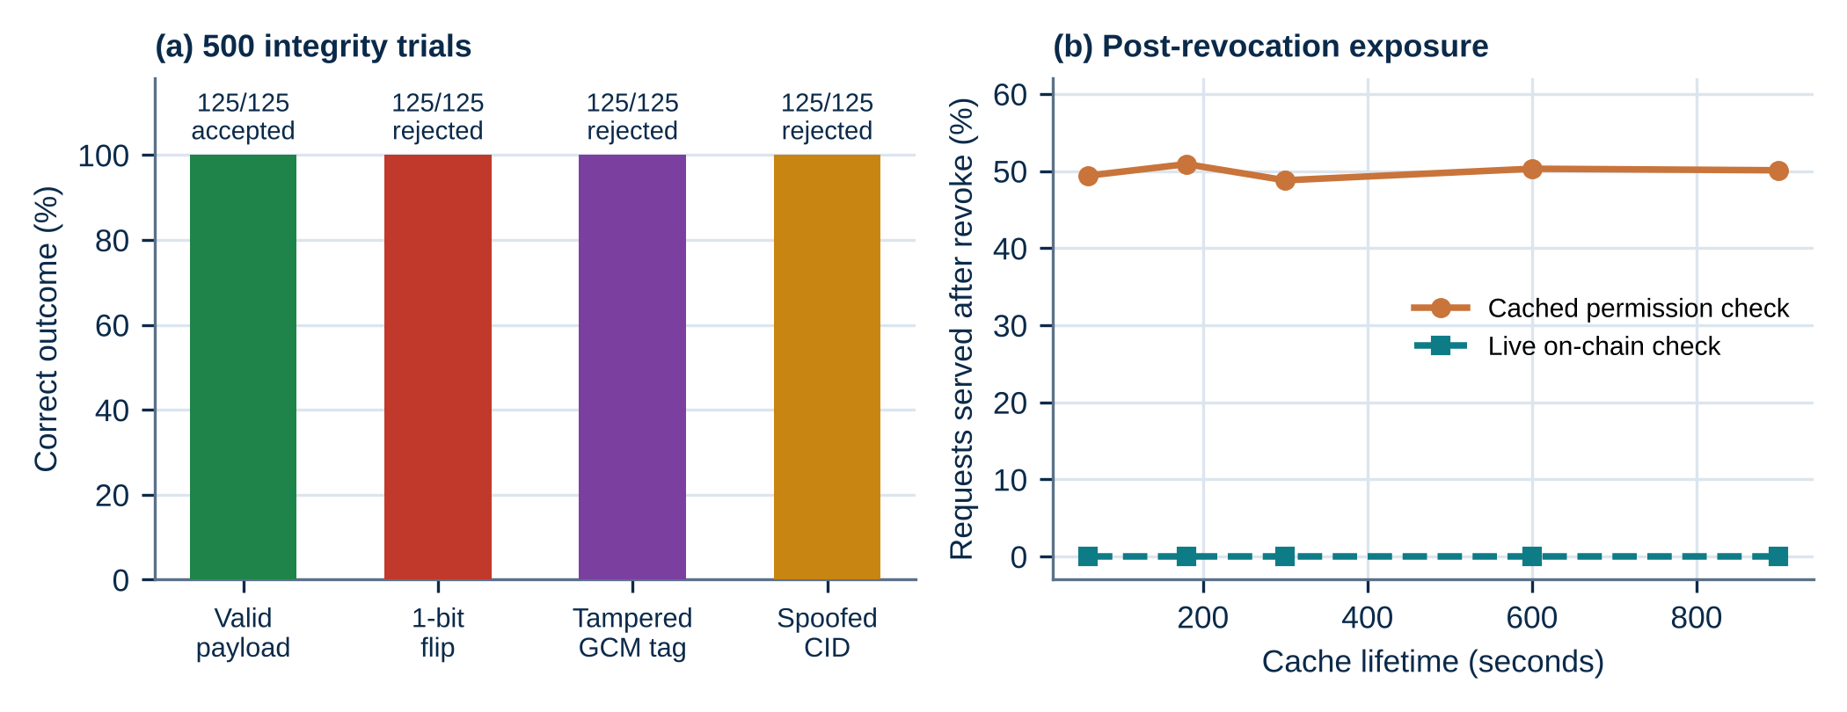
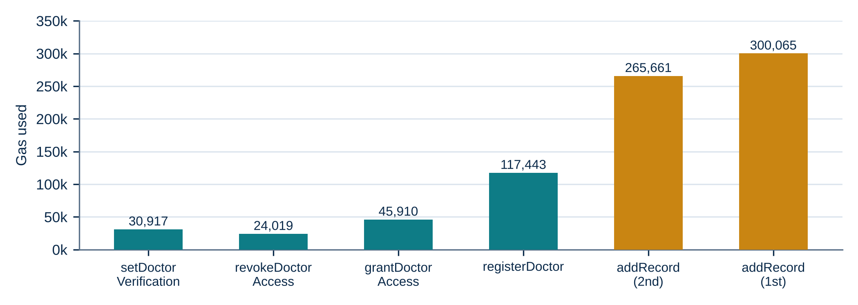
Experiments and Results (2 of 2): Benchmarks
Memory path wrote 0 bytes; the disk proxy wrote 423,901 bytes per file.
375 of 375 attacks rejected and 125 of 125 genuine requests accepted.
A cached permission served 49% to 51% of requests after a revoke; a live check served 0%.
Caveats: synthetic records, a simulated permission table, and timings that depend on the machine (Run A versus Run B).
Notes:
1,000 synthetic records, 500 integrity trials, cache lifetimes 60 to 900 s. The 0% for the live check follows from how it works, so the experiment shows the size of the problem it removes.

Slide 14
Conclusion and Future Work
Conclusion
Future Work
A patient-controlled record system was built from ordinary parts: contract, IPFS, wallet login and a gateway.
In the runs, a doctor was denied, then served, then denied on the first request after a revoke.
The memory path wrote 0 bytes to disk and every tampering trial was caught.
An upload costs about 300,000 gas whatever the file size.
Wrap each file key to the doctor's public key so the gateway holds no readable keys.
Add read logging, time-limited grants and a break-glass emergency path.
Measure on a public test network with realistic record sets.
Notes:
Close on what was built and measured, then the next steps.

Slide 15
References
[1] A. Azaria, A. Ekblaw, T. Vieira and A. Lippman, "MedRec: Using blockchain for medical data access and permission management," in Proc. 2nd Int. Conf. Open and Big Data, Vienna, Austria, 2016, pp. 25-30.
[2] Q. Xia et al., "MeDShare: Trust-less medical data sharing among cloud service providers via blockchain," IEEE Access, vol. 5, pp. 14757-14767, 2017.
[3] A. Dubovitskaya, Z. Xu, S. Ryu, M. Schumacher and F. Wang, "Secure and trustable electronic medical records sharing using blockchain," in AMIA Annu. Symp. Proc., 2017, pp. 650-659.
[4] A. Shahnaz, U. Qamar and A. Khalid, "Using blockchain for electronic health records," IEEE Access, vol. 7, pp. 147782-147795, 2019.
[5] G. S. Reen, M. Mohandas and S. Venkatesan, "Decentralized patient centric e-health record management system using blockchain and IPFS," in Proc. IEEE CICT, 2019, doi: 10.1109/CICT48419.2019.9066212.
[6] I. C. A. Pilares, S. Azam, S. Akbulut, M. Jonkman and B. Shanmugam, "Addressing the challenges of electronic health records using blockchain and IPFS," Sensors, vol. 22, no. 11, art. 4032, 2022.
[7] T. H. Romel et al., "A patient-centric blockchain framework for secure electronic health record management: Decoupling data storage from access control," arXiv:2511.17464, 2025.
[8] T. Kenaza, I. Debicha, Y. Fares, M. Sehaki and S. Messai, "A secure and interoperable architecture for electronic health record access control and sharing," arXiv:2602.20830, 2026.
[9] "Patient-empowered data management: A secure blockchain architecture with decentralized ownership," U.S. Patent 12,235,984 B1.
[10] W. A. Yoon and A. Casella, "Blockchain for managing access to medical data," U.S. Patent 11,244,059 B2.
[11] "Inter-hospital electronic medical record access authentication protocol based on blockchains," U.S. Patent 12,292,997 B2.
[12] H. Tang et al., "Block chain-based medical electronic medical record distributed management system and preparation method thereof," Chinese Patent CN 112863629 B.
[13] "Patient authorized medical information storage and access system," U.S. Patent 11,862,304 B1, Health2047, Inc.
[14] J. Benet, "IPFS - Content addressed, versioned, P2P file system," arXiv:1407.3561, 2014.
[15] M. Dworkin, "Recommendation for block cipher modes of operation: Galois/Counter Mode (GCM) and GMAC," NIST SP 800-38D, 2007.
Notes:
References are numbered as cited in the literature slides.

